Slide 1
W3 Content Accessibility
HTML Lads

Slide 2
notes
Html accessibility tags - https://www.w3schools.com/html/html_accessibility.asp
ARIA landmarks - https://www.w3.org/WAI/GL/wiki/Using_ARIA_landmarks_to_identify_regions_of_a_page
WCAG Guidelines - https://www.w3.org/TR/WCAG21/
More than disabilities - Slow connection, small screen, touch vs keyboard, low memory + cpu, etc. Profile/throttle using devtools!
Google Lighthouse for analyzing accessibility (F12 -> Lighthouse)
Reduced motion mode (@media (prefers-reduced-motion))
“Skip to content” hidden link (2.4.1)
Color contrast ratio > 4.5:1 (1.4.3)
Error Prevention: Reversible submissions, checked data inputs for user errors, confirmation of order/payments before checkout.

Slide 3
Screen Reader
Many accessibility tools rely on being able to extract plain text content from pages, including text-to-speech, braille readers, etc. This relies on correct and consistent use of HTML elements:
Use <button> for clickable elements, <li> for list items, …
Avoid using CSS to style one element to look like another - always use the correct base element and style from there.
“Semantic” elements - types which clearly define their content. <table> vs <div>
Use correct headings, sections, and ARIA landmarks to improve navigation through screen readers.

Slide 4
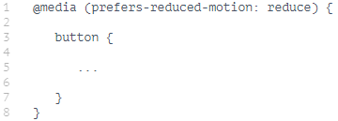
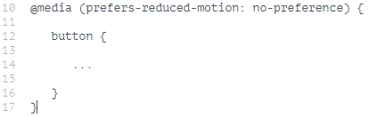
Reduced motion
Users could potentially have a neurological diagnosis that needs to be considered when designing any webpage. Flashing images/colors and excessive animations can induce a seizures and epilepsy. Taking note of this we will be implementing a reduced motion system to reduce the possibility of this occurring.
prefers-reduced-motion will be able to determine from the users whether they need minimal/reduced animations
Notes:
Less of a system, more of carefully implemented animations, flashing images,

Slide 5
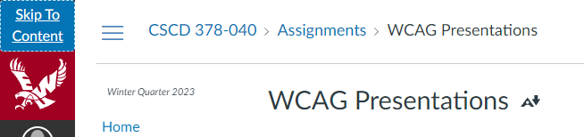
Keyboard/Tab Navigation
Many users rely on a keyboard to navigate the web instead of touch and mouse input. It is vital that a page is fully accessible using only the keyboard, and accessing important features via keyboard is quick and easy.
Caret browsing: Structure HTML document in such a way that users preferring caret (arrow key) navigation can effectively navigate the page.
Sequential Focus: Provide a link, accessible by pressing tab when the page loads, to jump to page contents directly. Make use of tabindex and semantic document structure to provide intuitive navigation with the tab key.

Slide 6
Input Assistance
All users are vulnerable to input errors and in the context of e-commerce this could mean incorrect orders or loss of business. We need to ensure the input errors are automatically detected and communicated to the user in text.
Text is readable by assistive technologies and can clearly communicate when and where the error occurred and how the user should correct it.
Labels and instructions should be included with each piece of content that requires user input (card information, address, name, etc.)
Websites should be automatically checking user input and displaying text if the input is not in the expected format. (display expected data type as text)
Give users an opportunity to review input before submitting to ensure correctness (especially critical for shipping and payment information)

Slide 7
Use of color
There are users who may not be able to distinguish some colors, so making sure that if we use color to distinguish when a field is missing or there is an error on logging in, they too are able to understand their mistakes.
Required fields when a user is purchasing a product will not only be in red, if missed as well it will have an exclamation point to signify its importance
When submitting for a purchase order, our button could be green once all required fields have been confirmed that they are filled out. Adding large text that says Submit order, as well as bold text pointing the user to the button.

